Slide 1

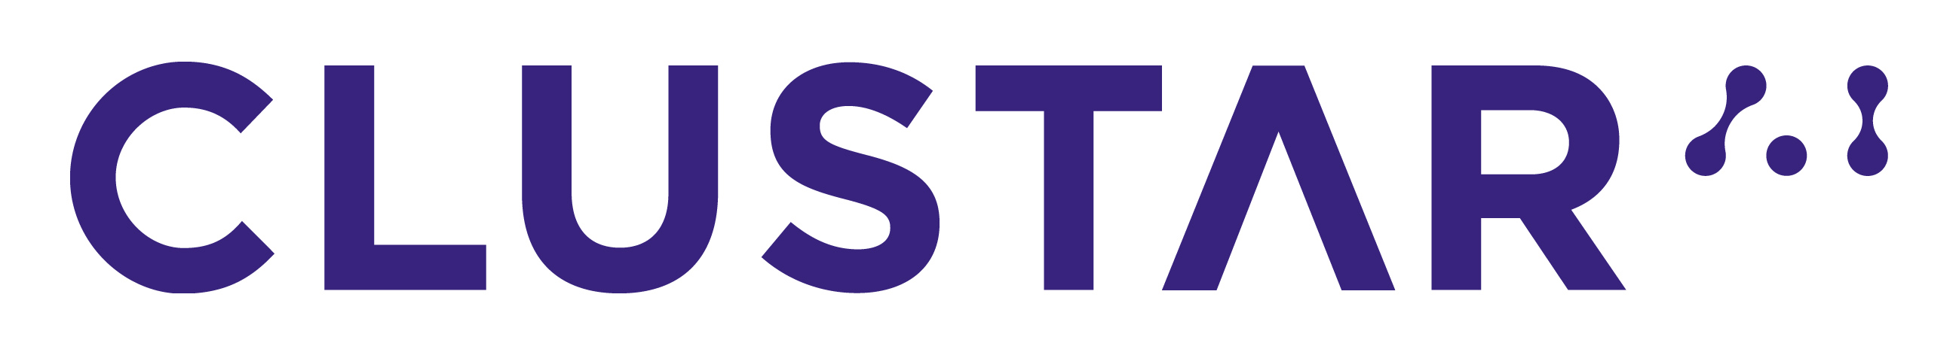



Rethinking Transport Layer Design for Distributed Machine Learning
Jiacheng Xia¹, Gaoxiong Zeng¹, Junxue Zhang^{1,2}, Weiyan Wang¹, Wei Bai³, Junchen Jiang⁴, Kai Chen^{1,5}
Notes:
Hello everyone I‘m Jiacheng Xia from SING lab, HKUST. Today I’m presenting our work titled “Rethinking Transport Layer Design for Distributed Machine Learning”.
(Loud) In this work we are presenting an import feature that DML tolerates data loss to a certain degree, and we argue that a transport layer protocol that leverages such features brings a non-trivial improvement for DML speed.

Slide 2

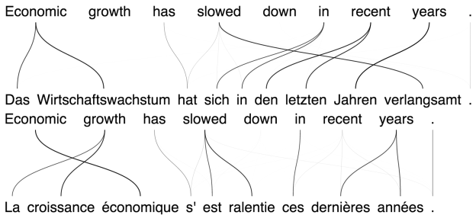
Growth of Machine Learning
Growing applications of AI, many of them leverages “machine learning”.
Our work: Running distributed machine learning over reliable data transfer protocol does NOT lead to optimal performance!
Notes:
In recent years we have seen the growing trend of artificial intelligence. Many AI applications leverages machine learning to solve a specific task, including …
To meet with growing trend of data, distributed training of models is often used to better leverage the computational resource available and increase the processing speed.
<While existing designs of DML systems rely on reliable transport protocols like TCP, in this paper we point out that this does not necessarily lead to best performance>

Slide 3
ML as Iterative Approximation
Many ML applications iteratively “learns” a mathematical model to describe data
Represented as minimizing obj. function
E.g. Stochastic Gradient Descent (SGD)
Notes:
<Why do we even argue that DML can run over a somehow unreliable data transfer protocol? To answer this question we first need to understand how machine learning works.>
The goal of many machine learning algorithms can be expressed as finding a model to describe the dataset. Typically it includes the process of finding a good mathematical model via iter. approx., for example, stochastic gradient descent algorithms.
The right side figure illustrates the contour map of an objective function. The goal of SGD is to find the minimized objective value, i.e. the yellow star representing the error of the model. The process of SGD is to go to the gradient direction (direction that’s orthogonal to tangent line) as a greedy reduction of loss value and approaches the minimizer with multiple iteration.

Slide 4
Distributed Machine Learning (DML)
After each iteration, workers exchange their parameter updates.
Often uses “synchronous training” for best performance → slowest worker determines speed
…
Parameter Servers
…
…
Workers
Data Shards
Notes:
We focus our discussions in data parallel training of DML. In data parallel distributed training, workers take a subset of data and exchange their training results every iteration.
The figure below illustrates parameter server. Where 1234
This update process is often "synchronized" for the best performance, that is, every worker needs to finish the current iteration and exchange their results with others before starting next one.
<This infers that a DML job's completion time is determined by the speed of the slowest worker>

Slide 5
Packet Losses in DML
Multiple flows simultaneously -> Likely to have losses (even TCP timeouts)
Small flows with a few RTTs, RTO >> FCT w/o timeout
Synchronous training, tail FCT determines job speed
S
S
S
S
W
W
W
W
Notes:
For DML tasks, recovering packet losses can be an expensive operation.
Firstly, DML traffics incurs multiple flows almost at the same time. E.g. Parameter Server architecture, two phases (click click click)
Secondly, these flows are small flows that can be finished within a few RTTs. In DC networks this is much smaller than a TCP timeout. As tail FCT determines job speed, the job will encounter a severe slowdown if timeout occurs.

Slide 6
Faster Computations
With growing speed of hardware, computations are faster, larger effect of timeouts
Model | Iteration time (no timeouts) | Slowdown w/ timeouts (RTO = 5ms)
MLP | 7ms | 2.4
Matrix Factorization | 6ms | 2.7
ResNet-18 (CNN) | 25ms | 1.4
LSTM (RNN) | 82ms | 1.12
Notes:
Furthermore, as the machine learning processors becomes more and more powerful, the time for completing one iteration becomes shorter. Some of them takes only a few milliseconds to complete. In such cases, if timeouts do occur in both the beginning and end of iterations, it adds a non-trivial overhead to the job. As the table shows, for such applications it may take more than twice of original time to finish.

Slide 7
High Cost of Loss Recovery
High recovery cost. E.g. TCP timeouts:
Fast computation, >2x longer completion time w/ timeouts
TCP w/o timeout
TCP w/ timeout
>2x completion time
Network
Compute
Worker pull
Worker push
Notes:
Why do we observe such a severe effect of timeouts?
We model the behaviour of a typical iteration in one worker. As the figure below shows, the iteration completion time is determined by the computation time locally and the communication time at the beginning & end of every iteration. If timeouts takes place at both pull & push phases, it adds 2*RTO to the original completion time. This overhead is significantly larger than the original time and therefore slows down the whole process.

Slide 8
Handling Packet Drops: Necessary?
Timeout as a “backup” to recover packet drops.
Is this necessary to handle every packet drop for DML?
NO.
DML is inherently iterative approximation, so it only requires approximately correct results.
DML algorithms (e.g. SGD) are greedy optimization, can recover from slightly incorrect results
Notes:
Typically timeouts serve as a "backup" mechanism to guarantee the protocol is reliable, that is, to recover every lost packets. <But we have seen the exceedingly high cost to do so for DML applications. At this point we take one step back and ask a fundamental question: Is it really necessary to respond to every packet drops in DML network transportation?>
The answer is likely to be negative. Firstly, as DML is inherently …, it only requires the results in each step to be approximately correct. Secondly, as many DML algo like SGD conducts greedy optimization, the error of previous iterations can be recovered from later iterations. Such features give us a chance to achieve same DML application performance (i.e., accuracy of a classification task) even with ignored packet drops.

Slide 9
ML are Bounded-Loss Tolerant
Same rounds, reduced JCT
More rounds,
reduced JCT
Do not converge
Emulate parameter loss locally, compute communication time with NS-3 simulations
Notes:
We mimic the packet drops in network by randomly marking a fraction of parameter values as "lost"
,Our key observation is that DML is BLT. To be concrete, the time-loss relation can be described in 3 phases.
In the first phase, as the data loss rate increases, the model still achieves same performance as baseline setting where no data is lost. There is some bound when exceeding this bound results in a increased number of convergence round or even do not converge. We mark the applications that fail to converge with 100 epochs as not converging.
What does this infer on job completion time? As the data loss rate that requires timeouts are only a small fraction of packet drops, it is safe to directly proceed without recovering these packets.

Slide 10
ML view of Bounded Loss Tolerance
SGD starts new estimation with results in previous iteration.
Can recover from ”incorrect” results
With bounded loss, SGD still converges to same point
Lossless SGD
“Lossy” SGD
Notes:
After the first iteration which gives an “incorrect” result, click, it does not take the same direction of gradients like the blue line in second iteration

Slide 11
Existing Solutions are Insufficient
Reduced communications?
Unreliable Protocol?
A “simplified protocol” to explain in the following has the potential to significantly outperform these settings.
Notes:
Despite this bounded loss tolerance feature, it can not be trivially applied to benefit DML.
Firstly, given, why not?
Using a completely unreliable protocol also does not solve the problem

Slide 12
Packet Drops on Different Schemes
Packet Drops occur on different parameter sync. schemes
Parameter Server (PS)
Ring AllReduce (RING)
Notes:
Besides, this problem widely exists in PS and RING schemes.
On the other hand, ignoring packet losses can significantly cut down tail flow completion time of DML. This motivates us to design a new protocol based on the bounded loss tolerance features.
The green bars shows the gain out of a simplified protocol we designed, we soon explain the setups in the next slide

Slide 13
A Simplified Protocol
Minimizes the time for receiver a predefined threshold of packets
TCP-like congestion control logic
Receivers notify application layers once received pre-defined threshold of data
Preliminary results in NS-3 simulators

Slide 14
Results: Simplified Protocol
[Simulation] 1.1-2.1x speed on both PS and RING scheme
Notes:
Note the results are model-specific, since some models are more computation intensive than the others.
"PS RING"
You can find detailed evaluation setup in our paper.

Slide 15
Reduced Tail FCT
The FCT reduction results from reduced tail FCTs.
A bounded-loss tolerant protocol benefits DML by ignoring some packet drops

Slide 16
Future Works
We have seen that leveraging Bounded Loss Tolerant has huge potential to speed up DML
A concrete testbed implementation of bounded loss tolerant protocols
Software prototype on top of this protocol

Slide 17
Summary
DML applications run with reliable data transfer – not necessarily the only way
DML applications are bounded-loss tolerant, due to its stochastic (iterative approximation) feature
Ignoring some packet drops significantly reduces job completion time without affecting performance

Slide 18
Thanks!
Q & A

